Slide 1
MER311: Advanced Strength of Materials
Failure Criteria

Slide 2
Design Factors or Factors of Safety
Factor of Safety
Margin of Safety

Slide 3
Material Properties

Slide 4
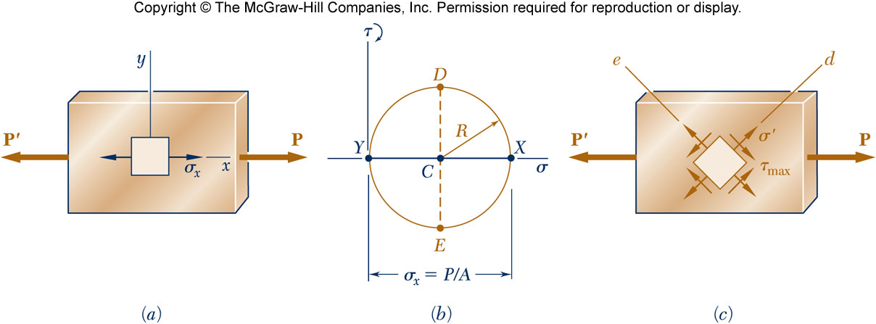
Example
Let P=5000lb and the cross-sectional area = 0.2 in².
What is the Factor of Safety and Margin of Safety?

Slide 5
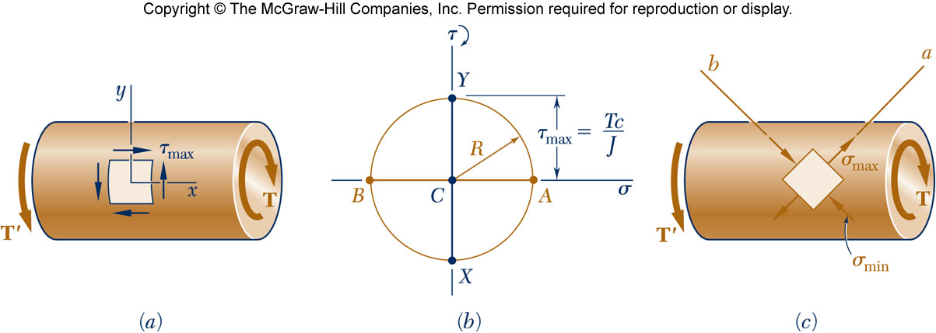
Example
Let T=200 ft-lb and r= 0.2 in (J=2.51x10⁻³ in⁴)
What is the Factor of Safety and Margin of Safety?

Slide 6
Unacceptable Deformation Under Load w/ or w/o Fracture
Excessive Elastic Deflection
Stretching, Twisting, or Bending
Buckling
Vibration
Yielding
Plastic Deformation @ Room Temp
Creep at Elevated Temperatures
Fracture
Sudden Fracture of Brittle Materials
Fatigue (Progressive Fracture)
Stress Rupture at Elevated Temperatures

Slide 7
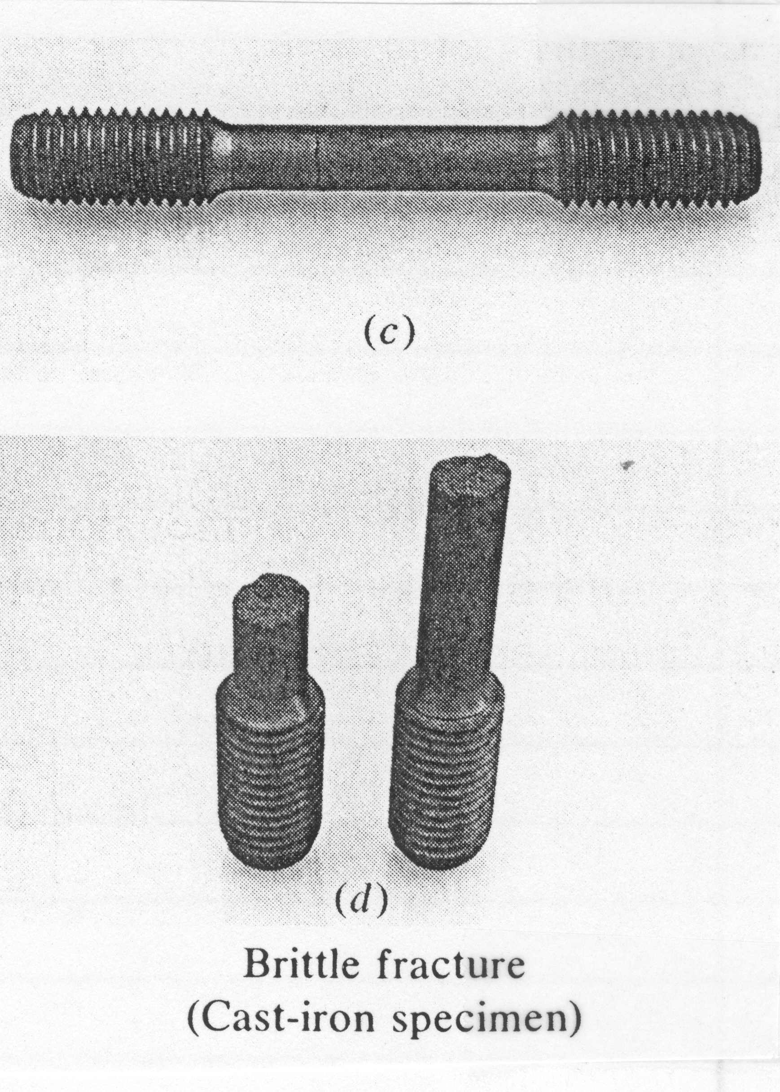
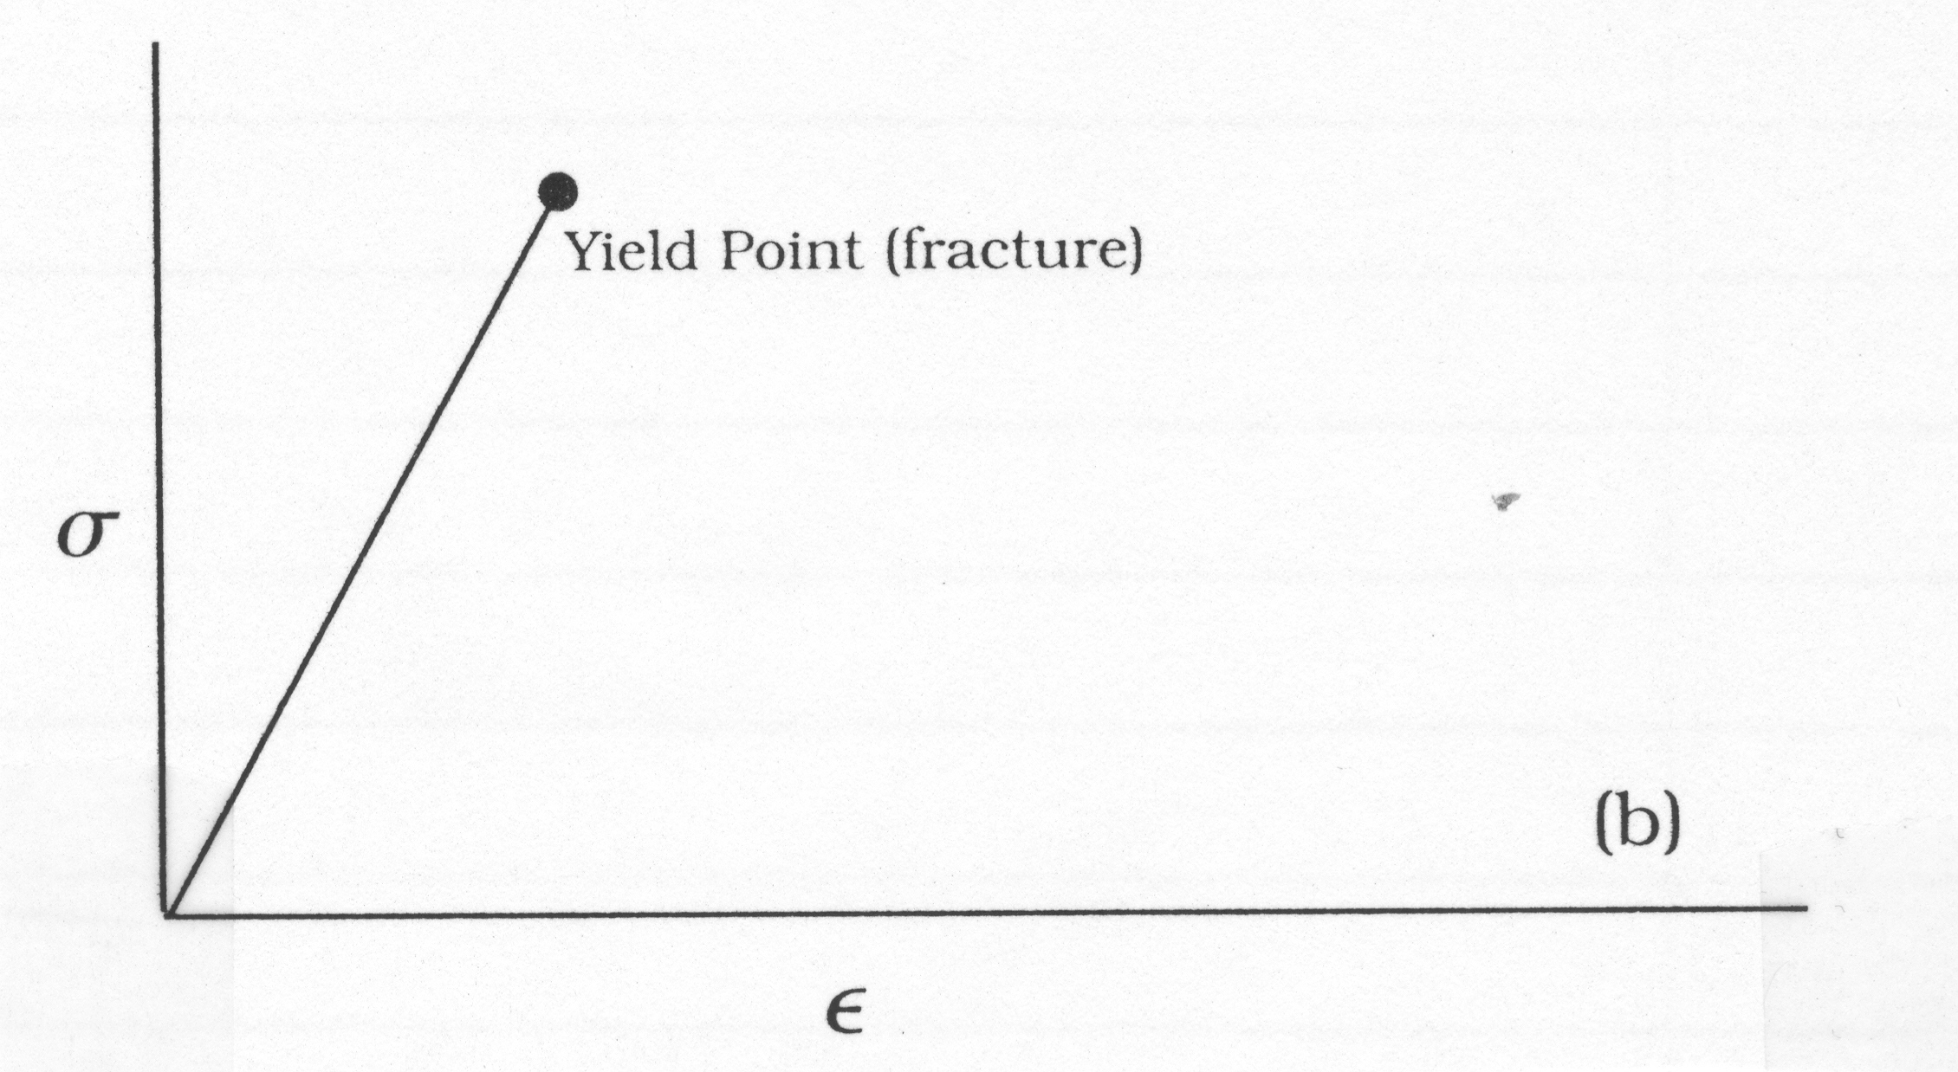
Typical σ-ε Curves - Brittle

Slide 8
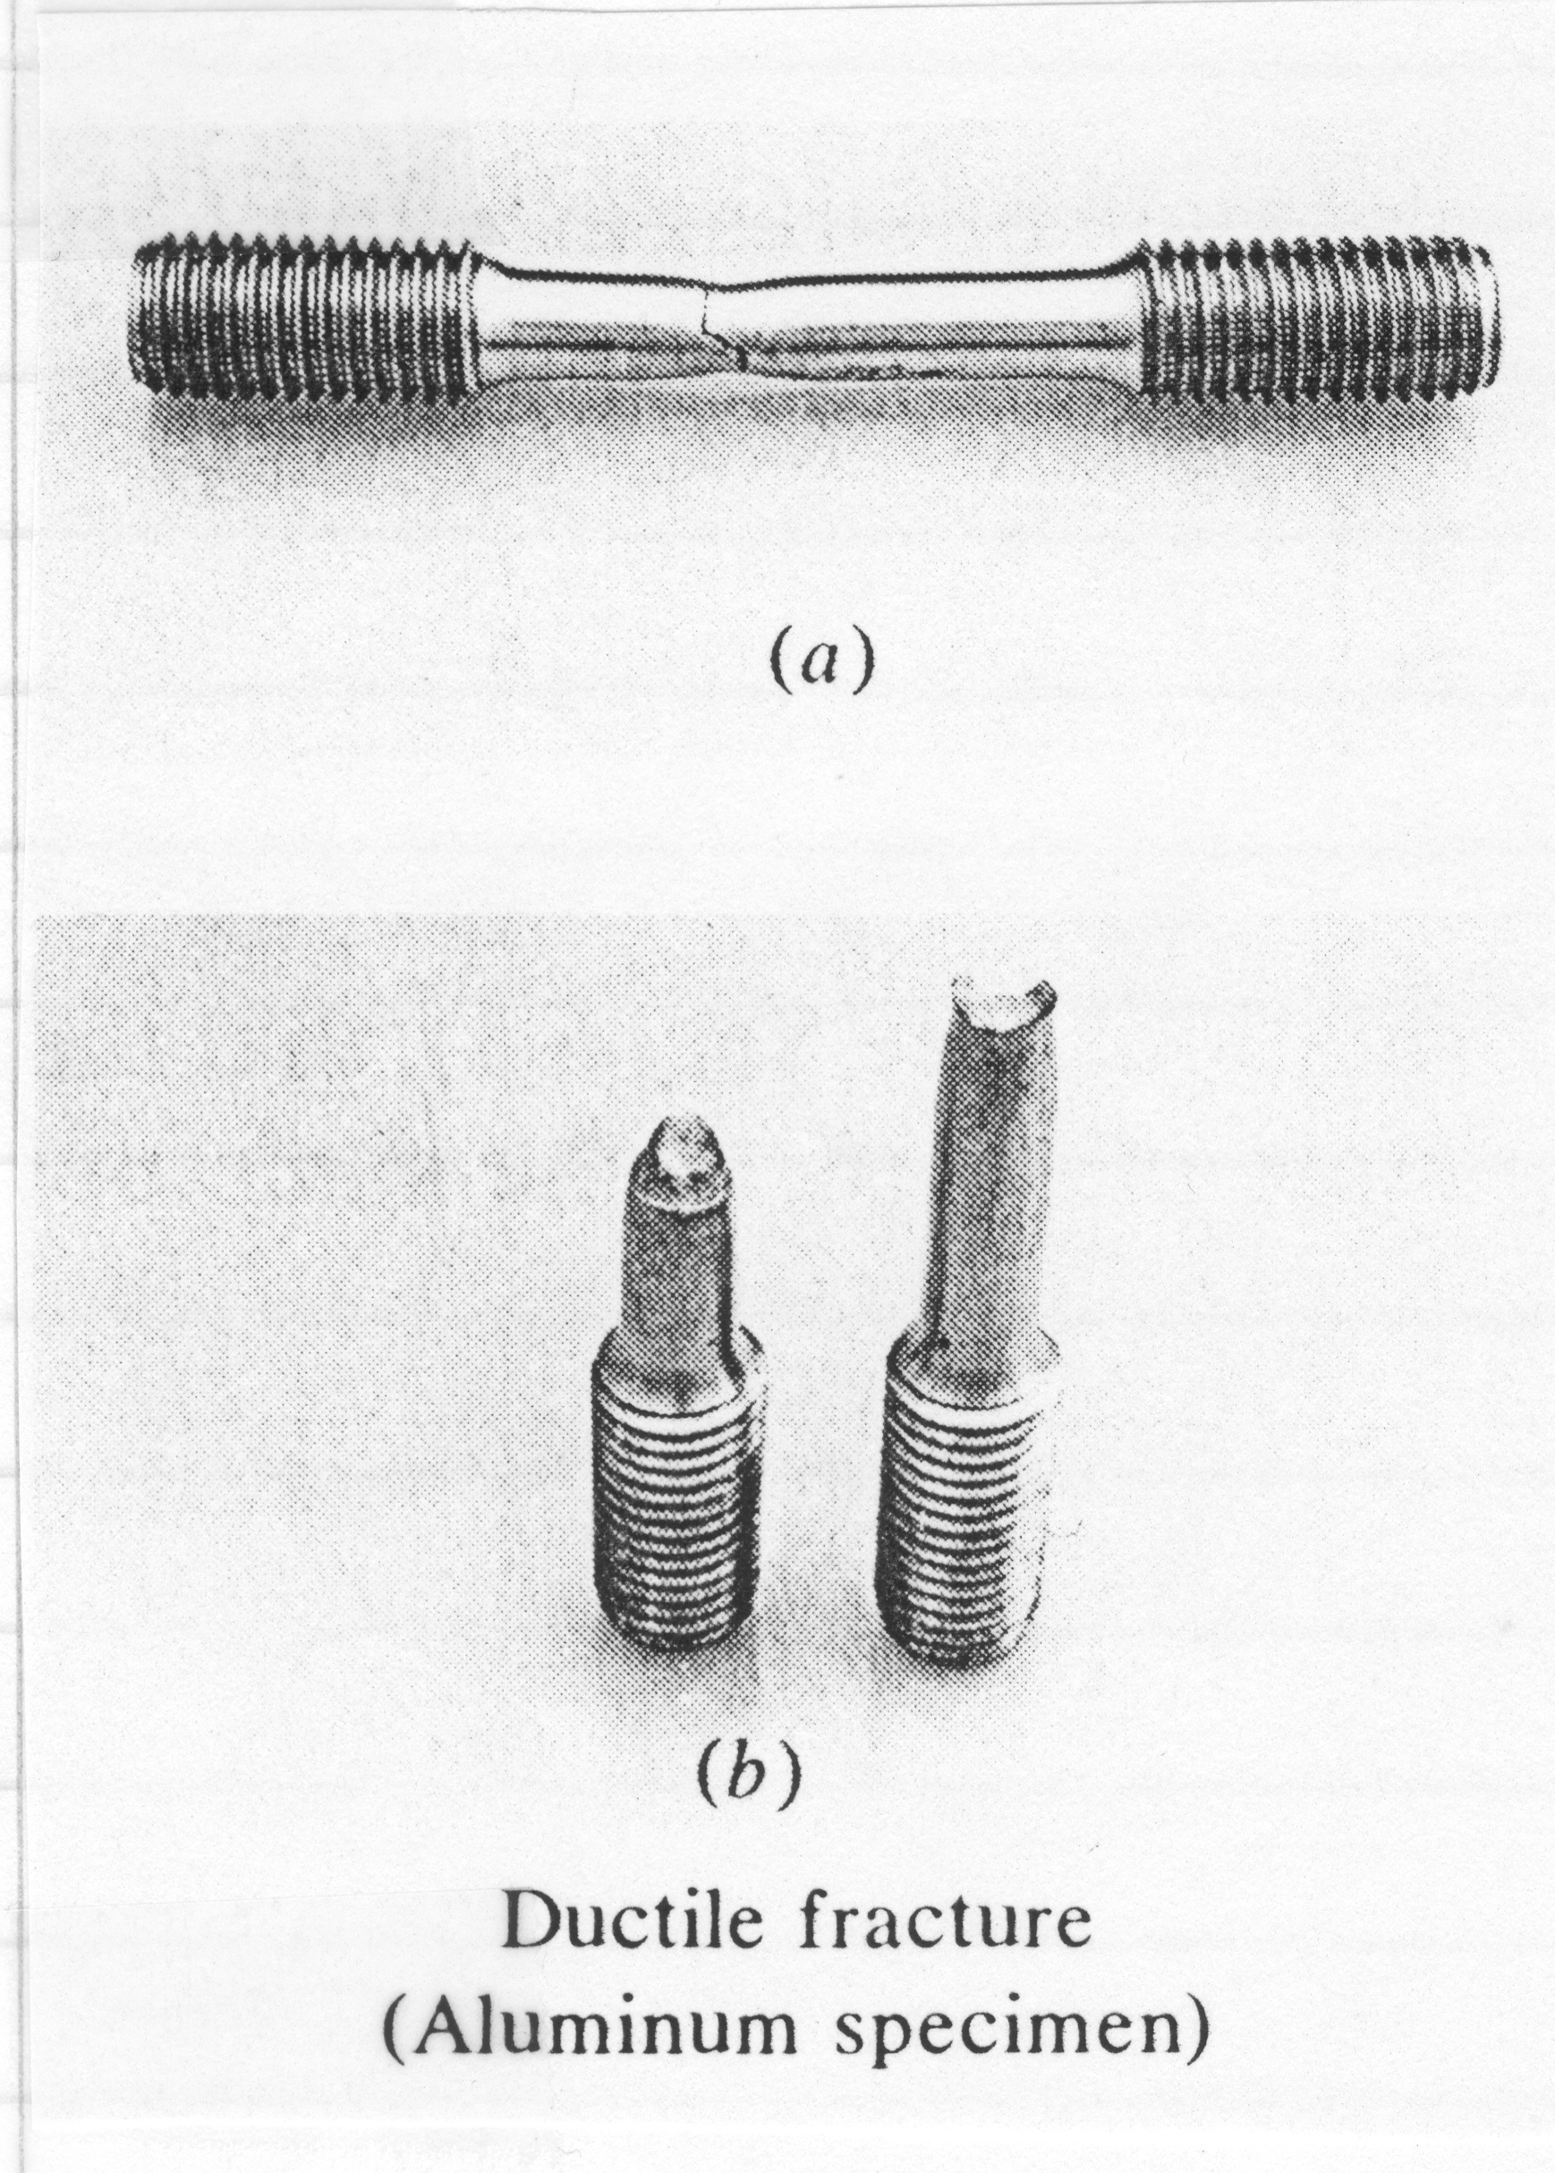
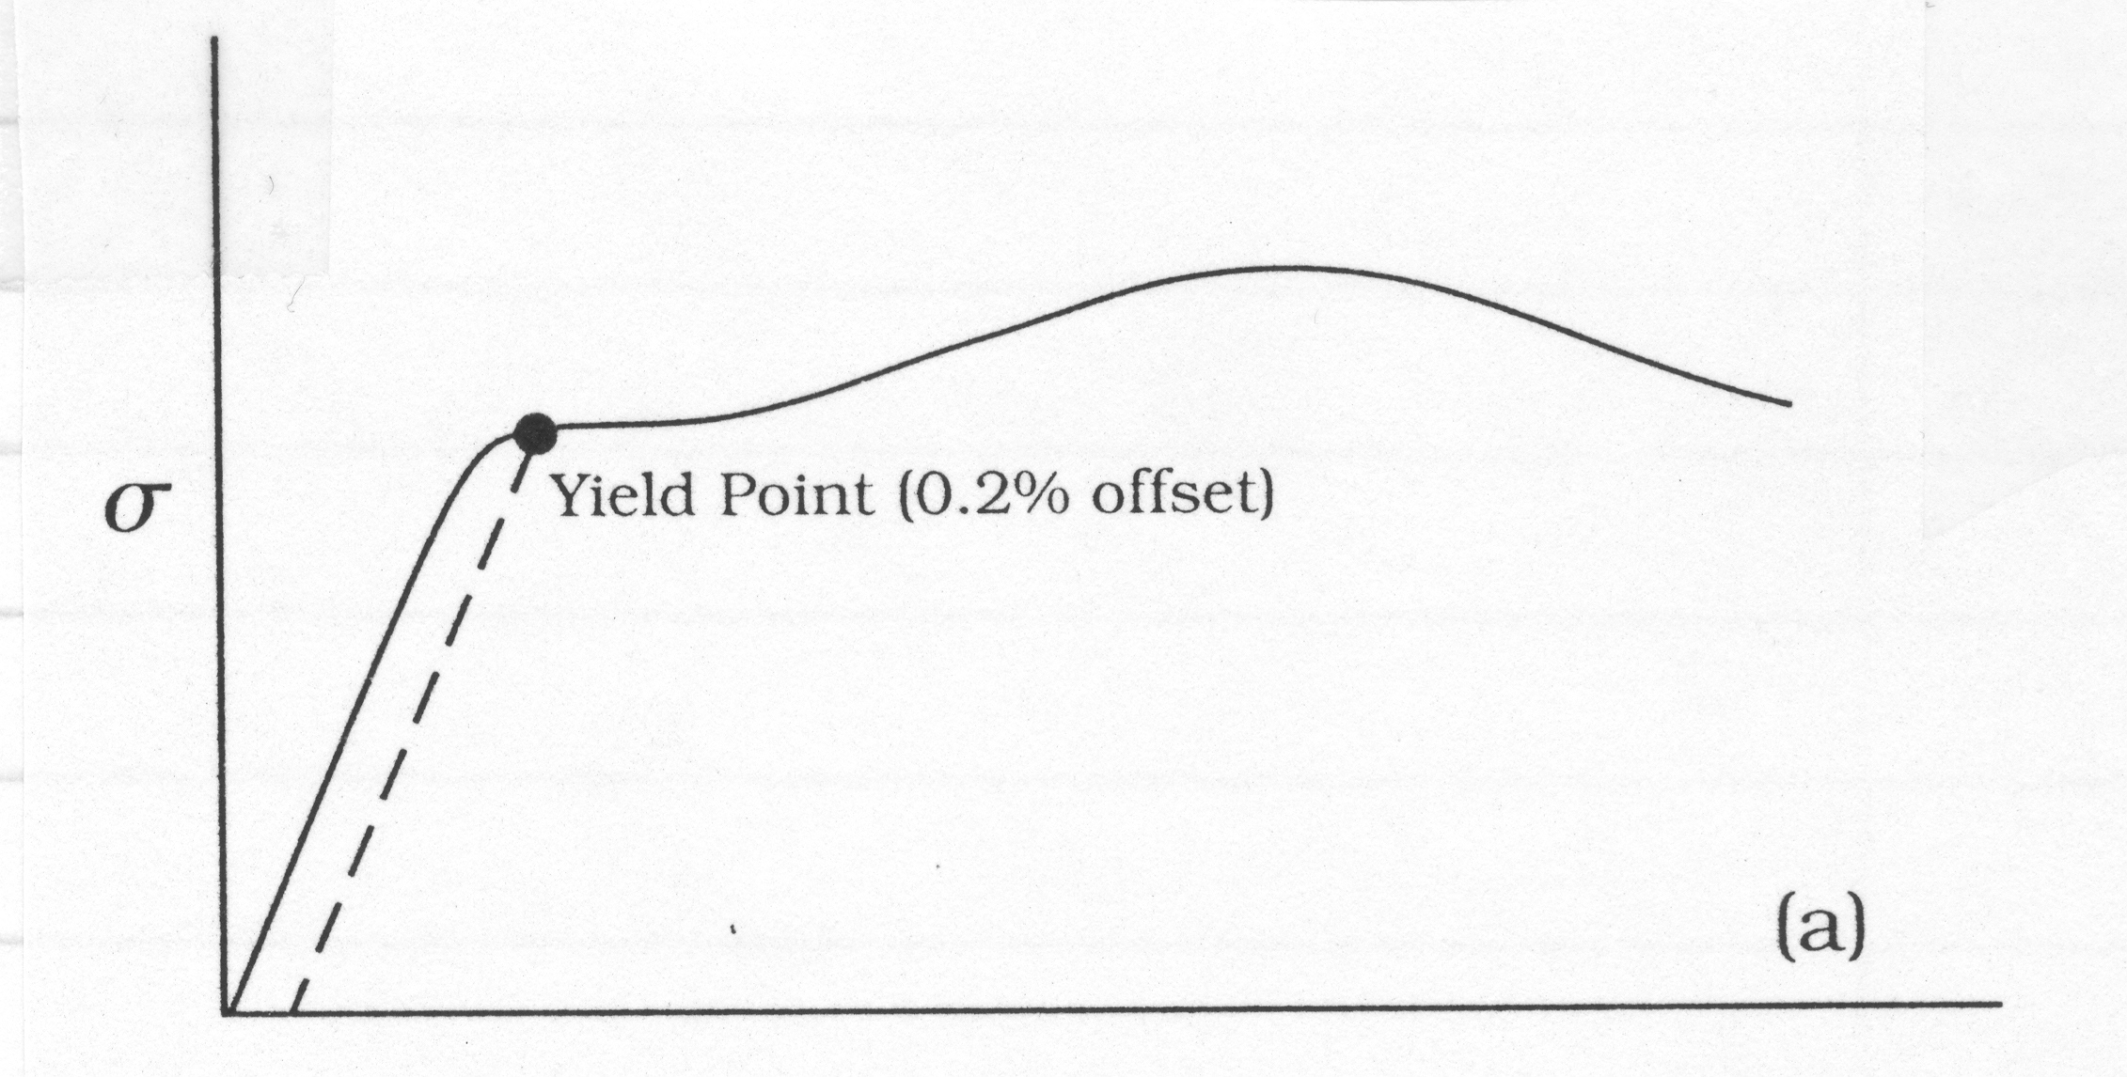
Typical σ-ε Curves - Ductile

Slide 9
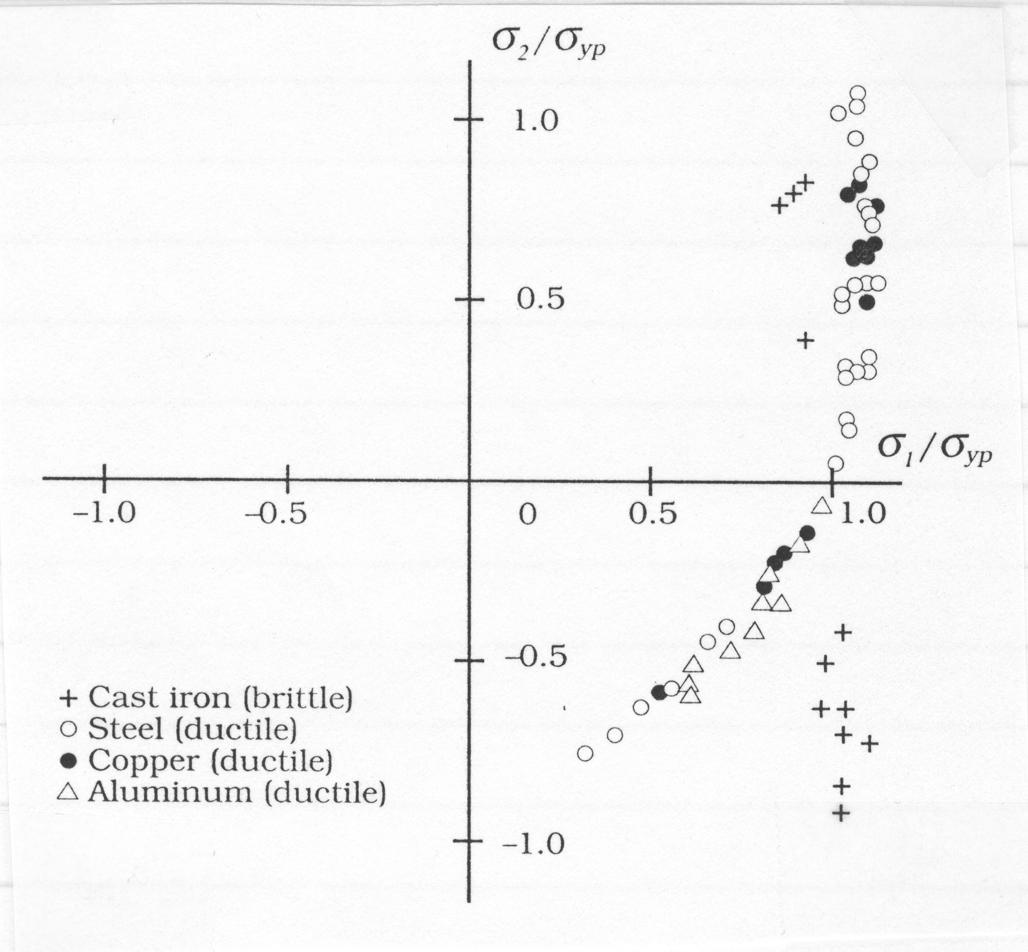
Multi-Axial Loading

Slide 10
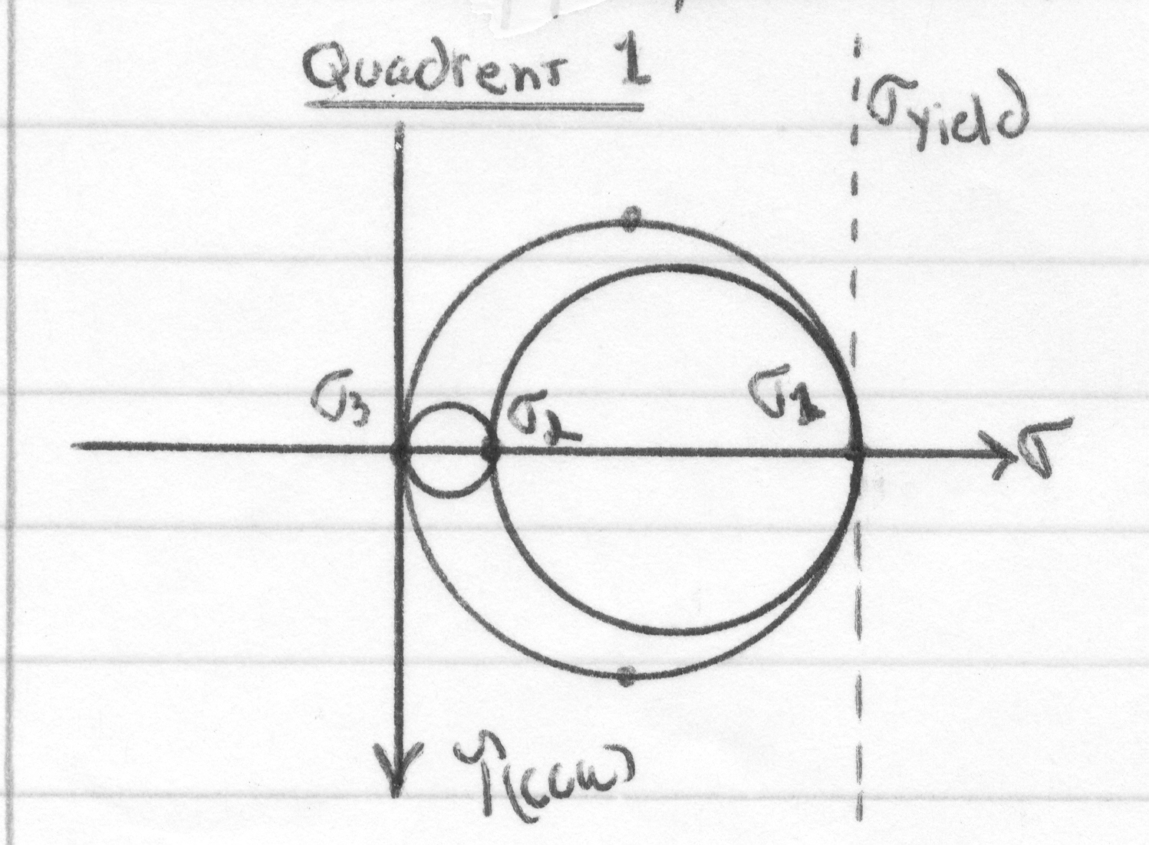
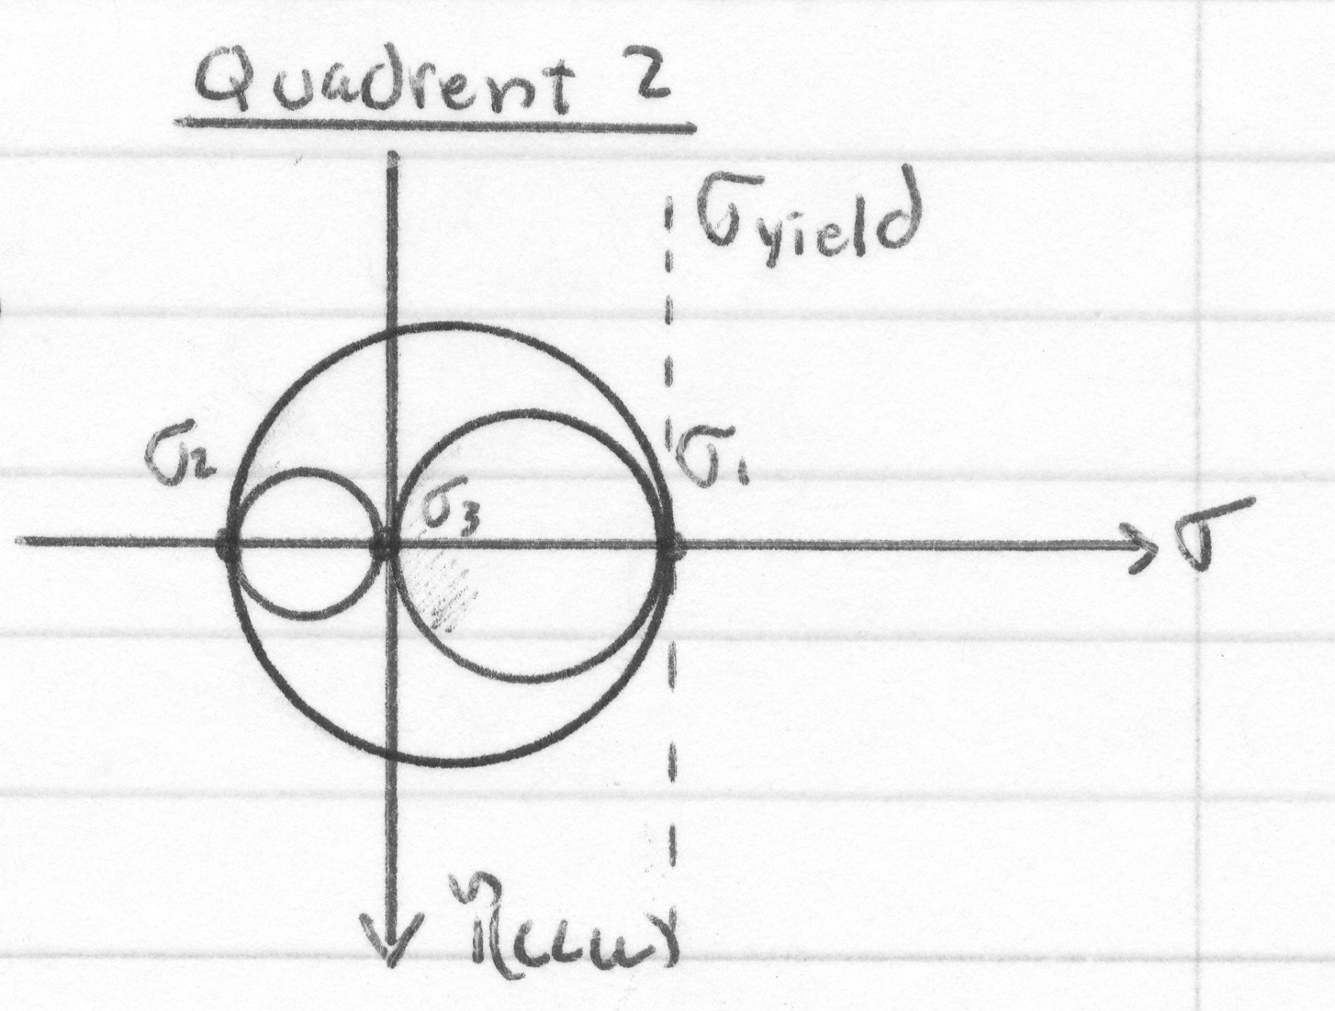
Multi-Axial Load

Slide 11
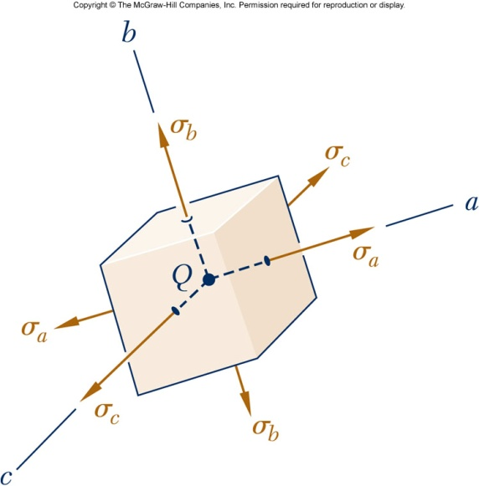
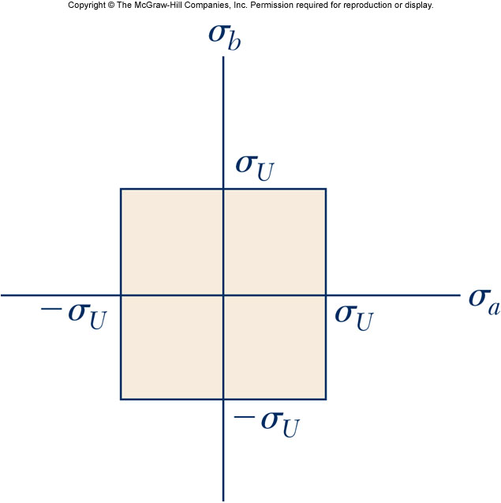
Maximum Normal Stress Theory Rankine Criteria

Slide 12
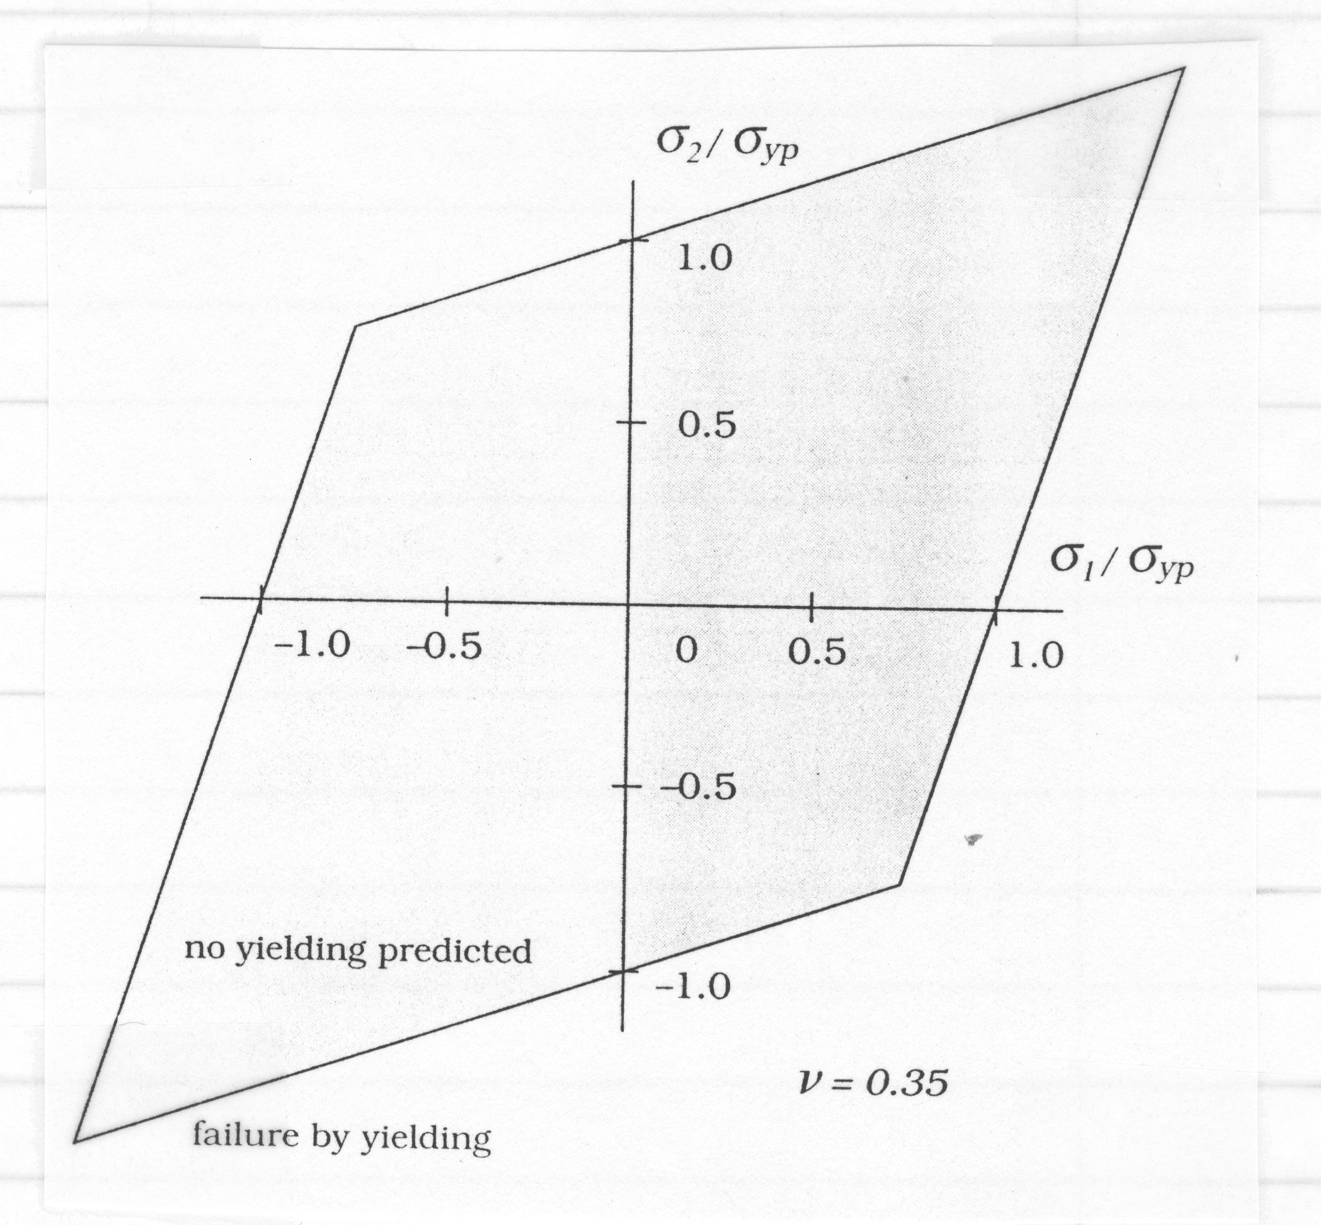
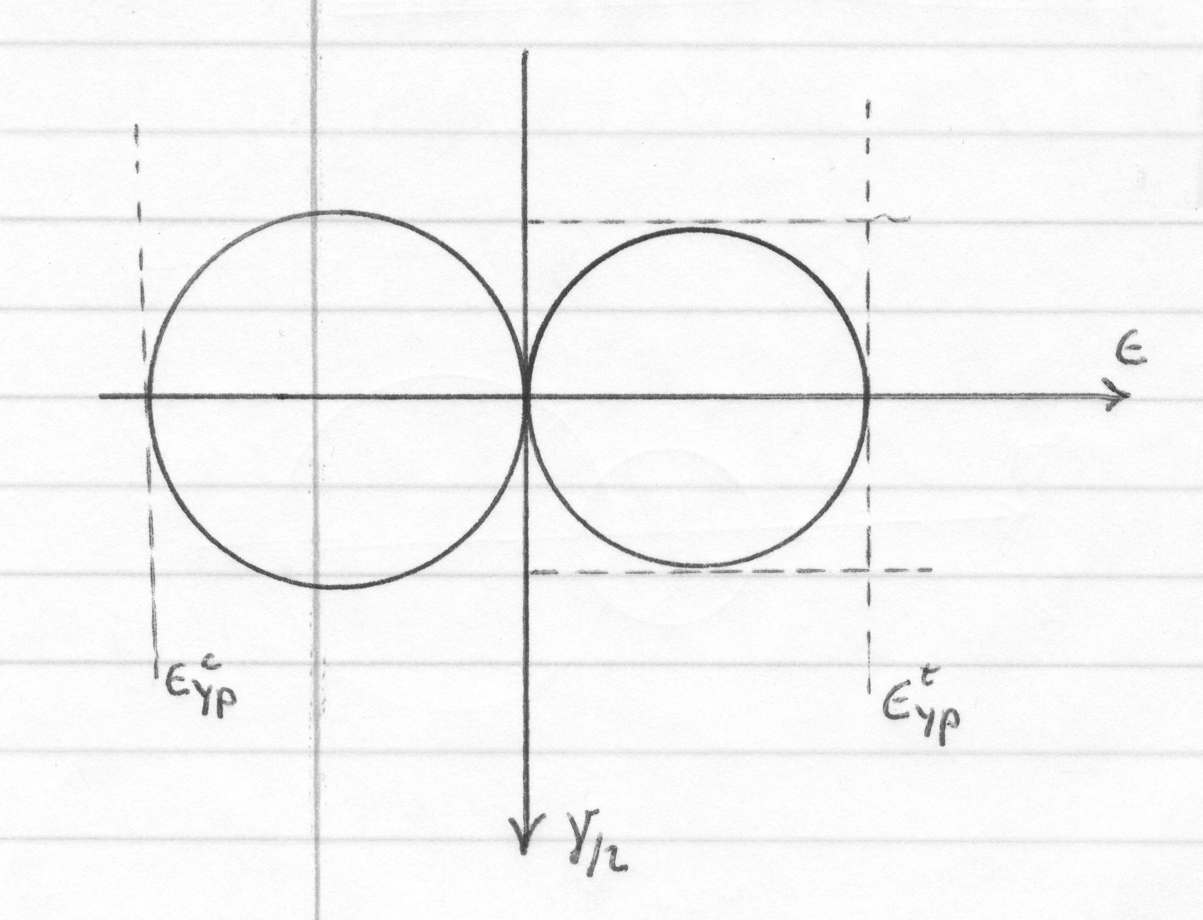
Maximum Strain Theory St. Venant Criateria

Slide 13
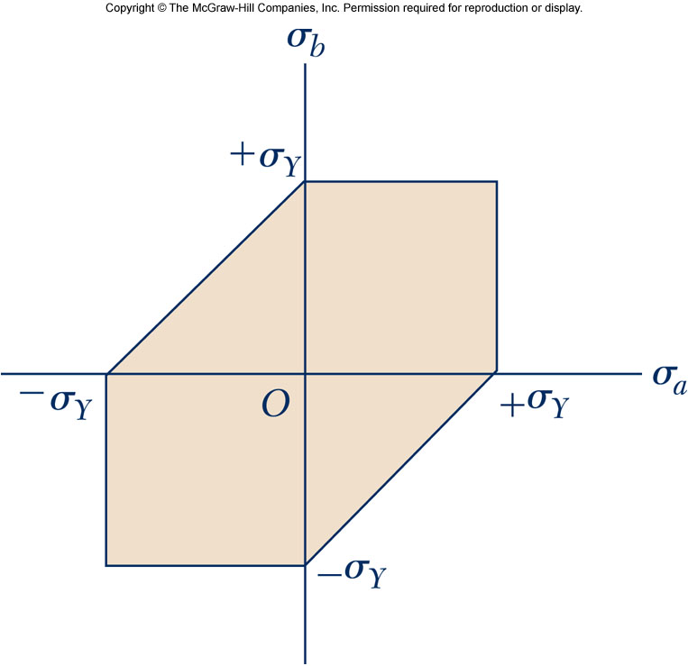
Maximum shear Theory Tresca Criteria

Slide 14
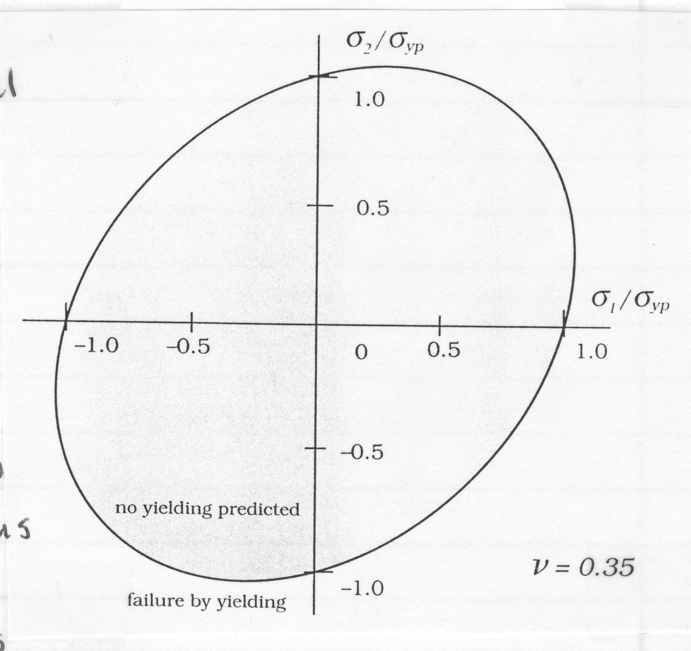
Maximum strain Energy Theory Haig Criterion

Slide 15
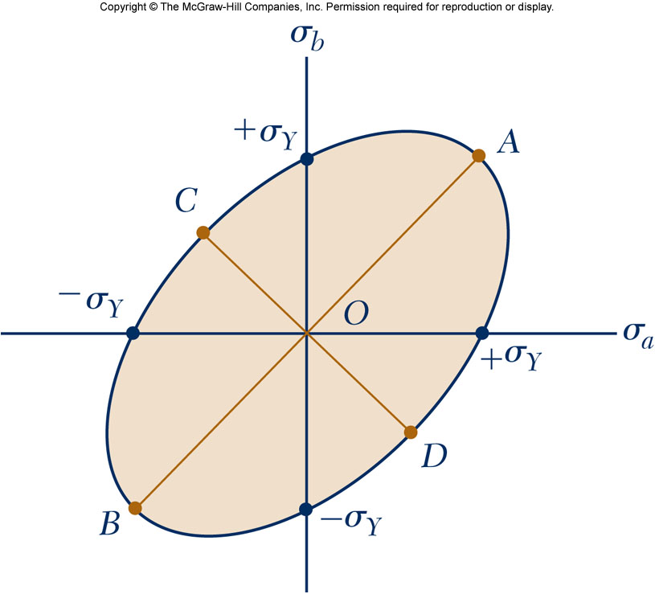
Maximum energy of Distortion Theory – von Mises Criteria

Slide 16
Maximum energy of Distortion Theory – von Mises Criteria

Slide 17
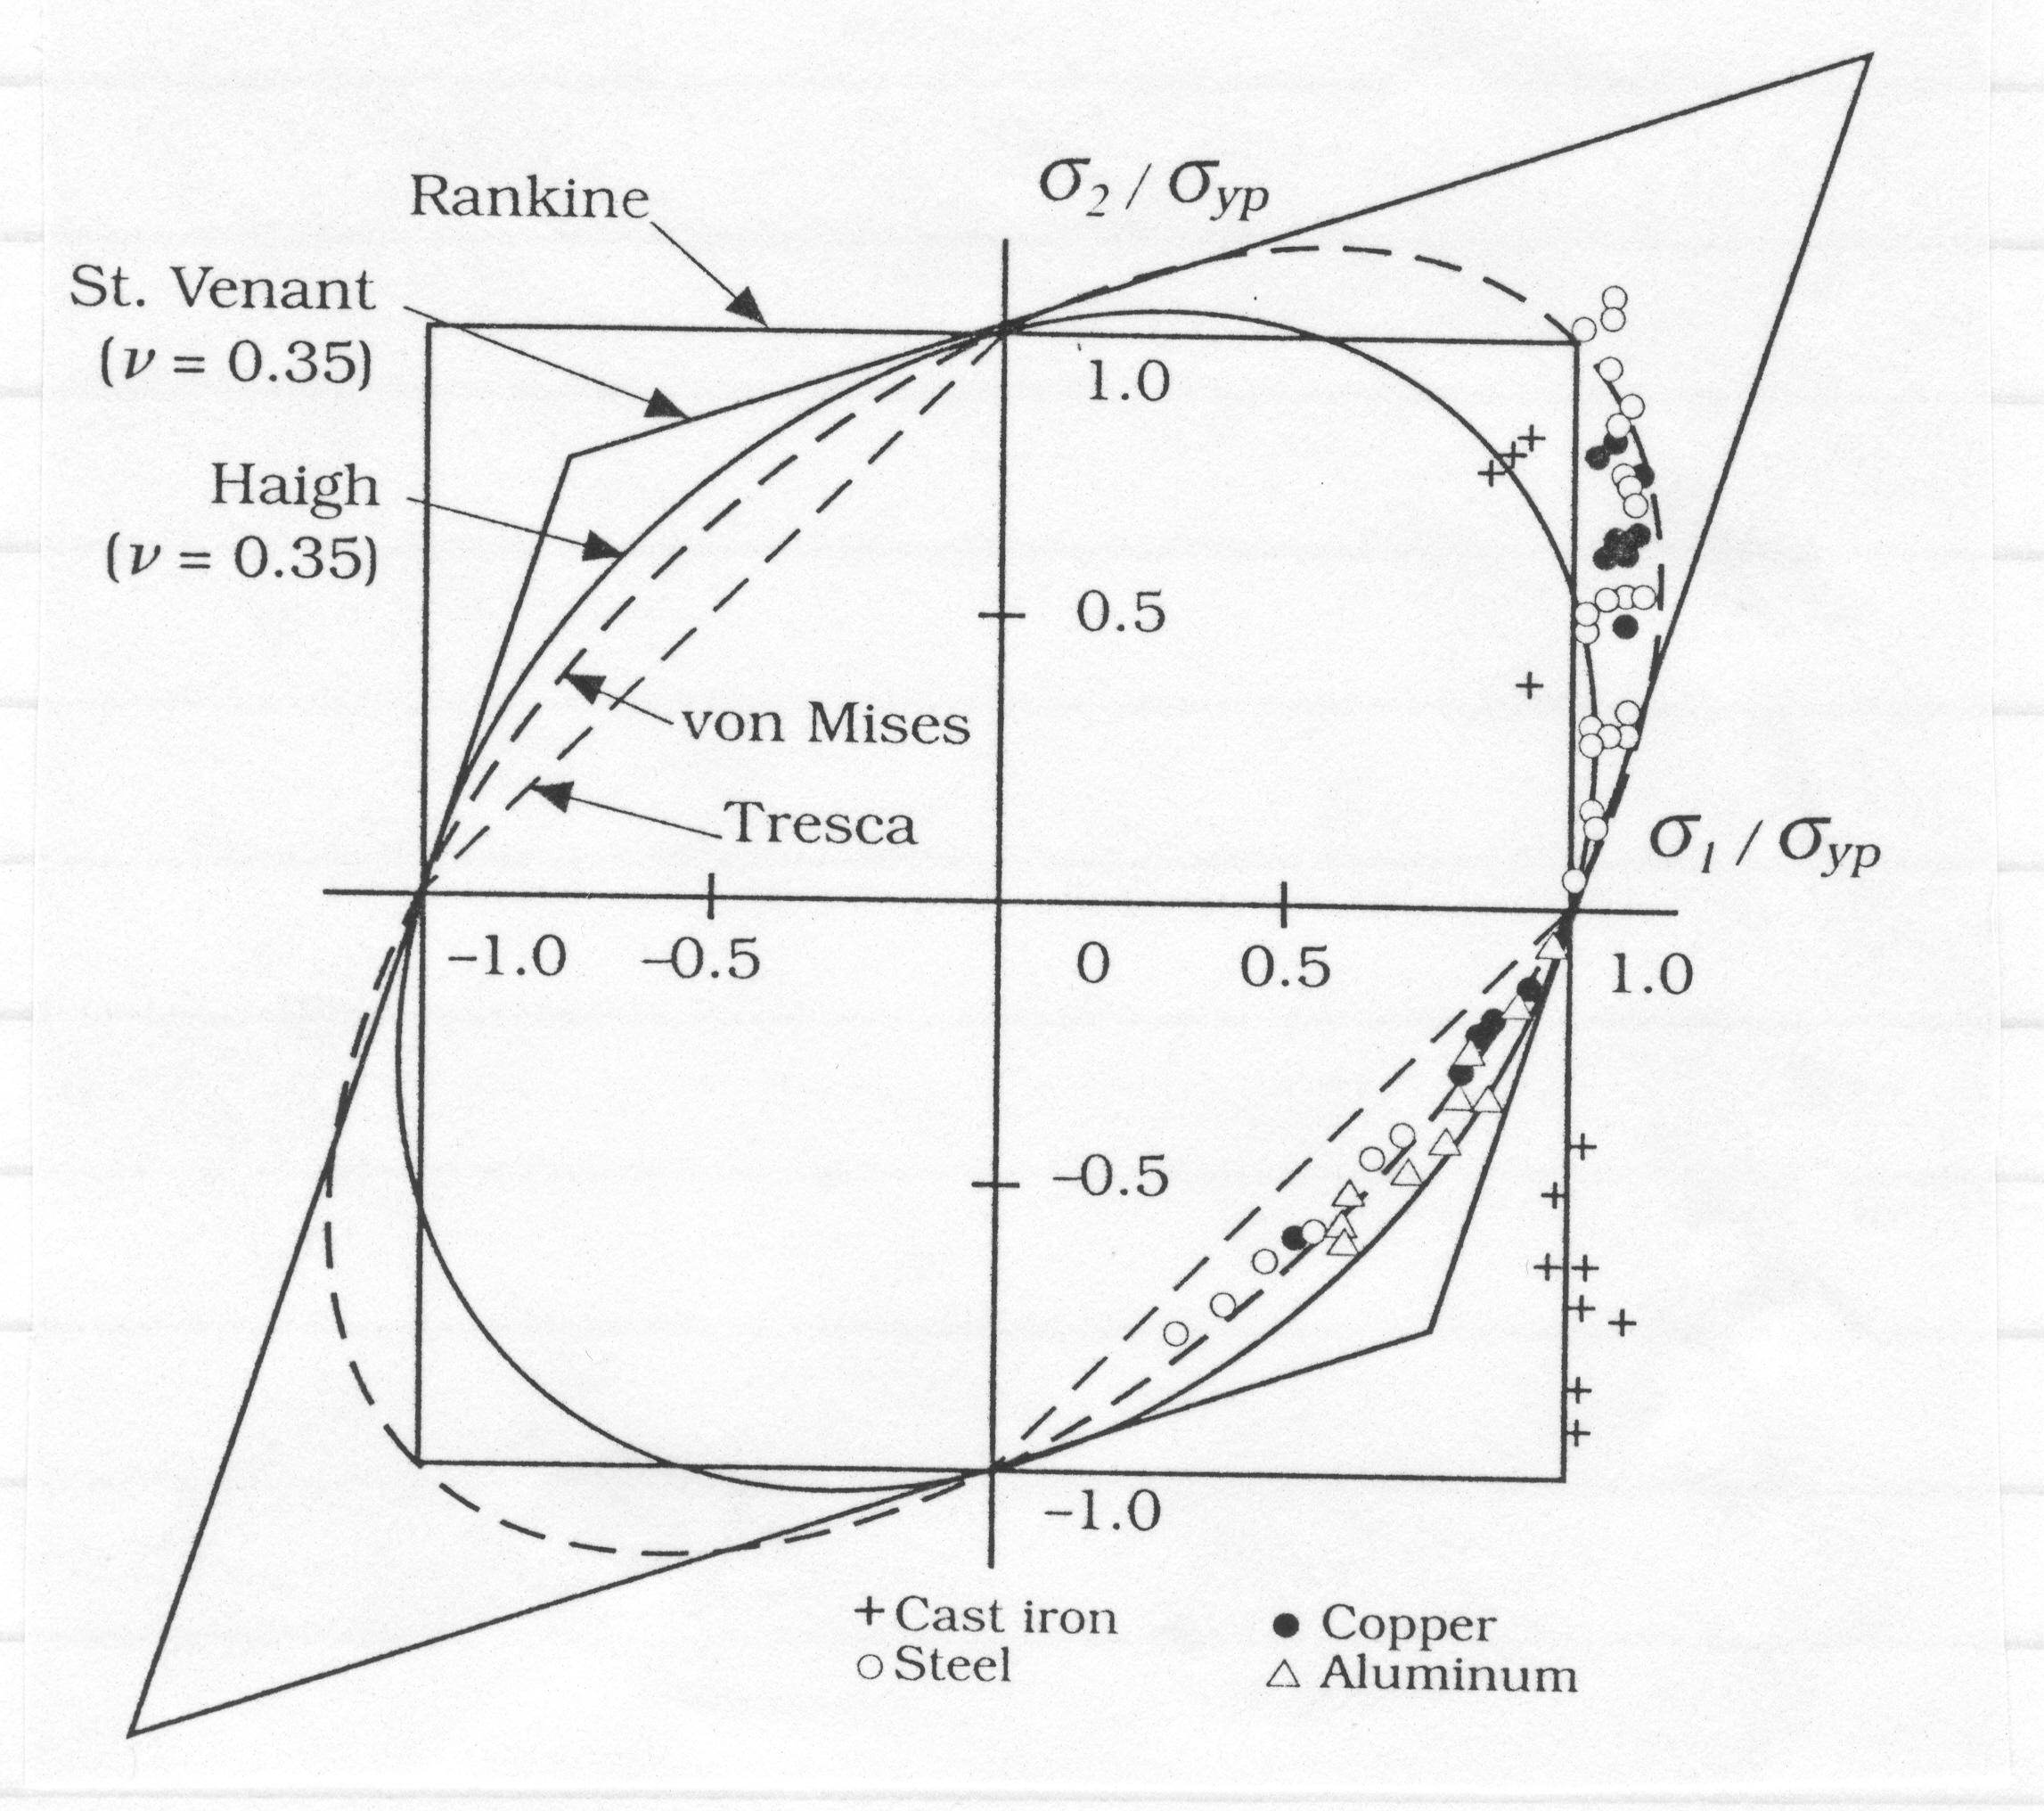
Comparison with Data

Slide 18
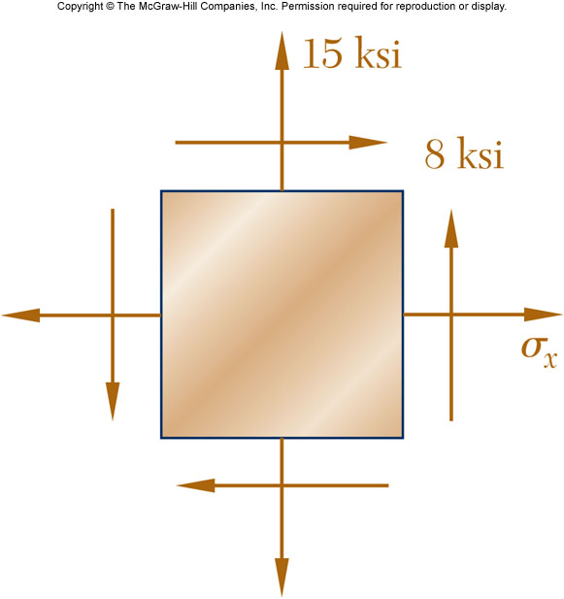
Example

Slide 19
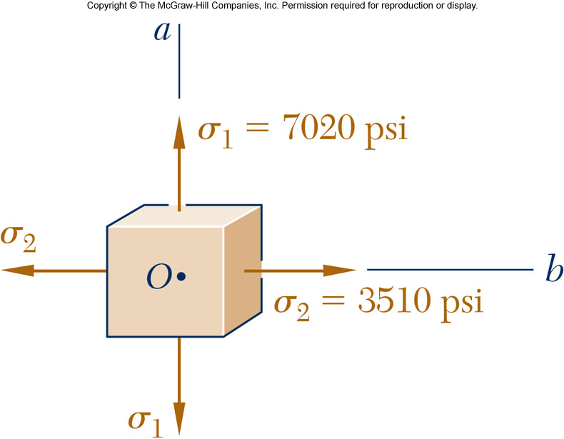
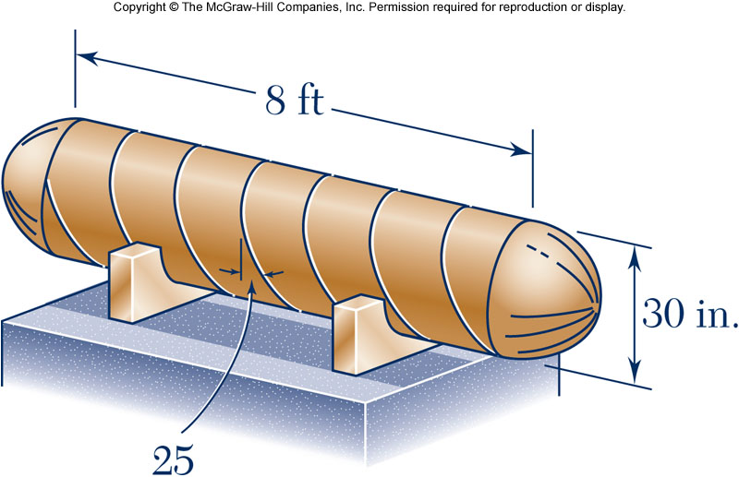
Example

